Slide 1
Lumber Sizing
Are you framing a house or building a bookshelf?
Woods Class

Slide 2
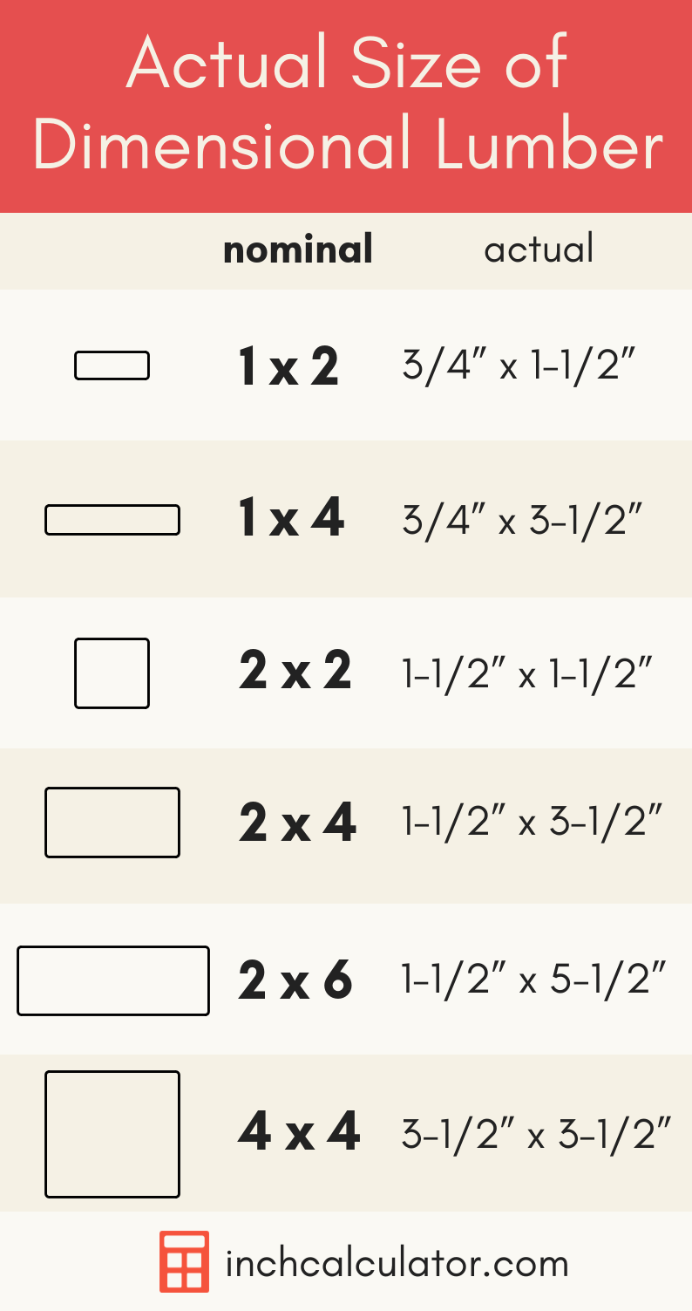
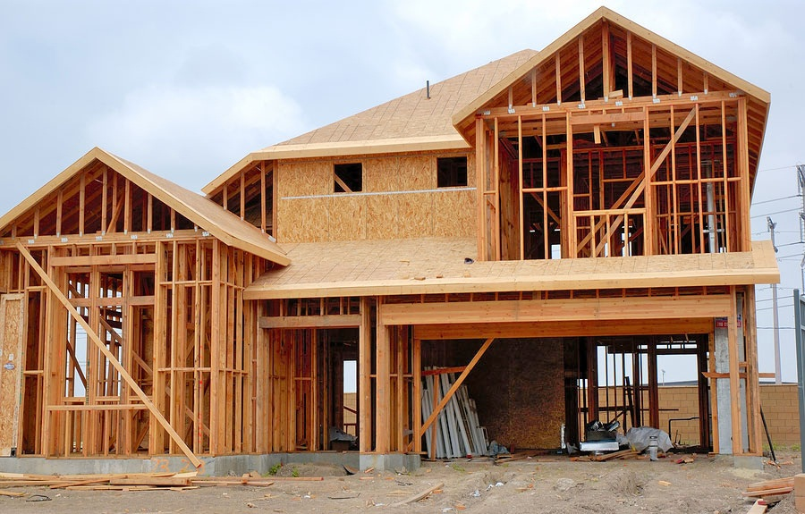
Dimensional Lumber
The term dimension lumber is used with softwood species (such as pine or fir) that are used in the building trades for framing and other carpentry uses.

Slide 3
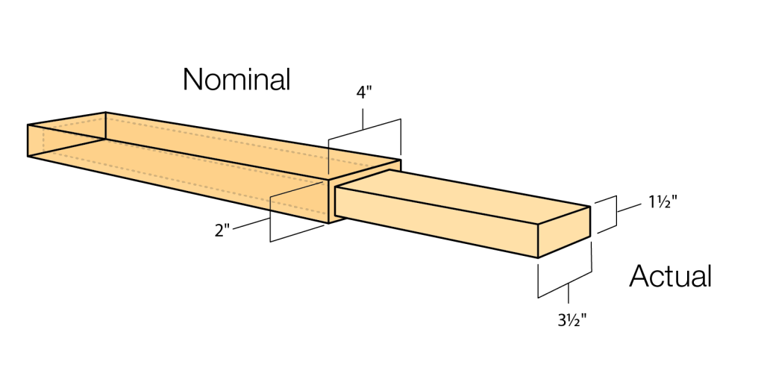

Slide 4
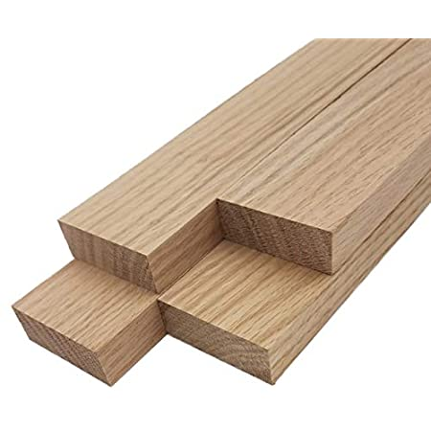
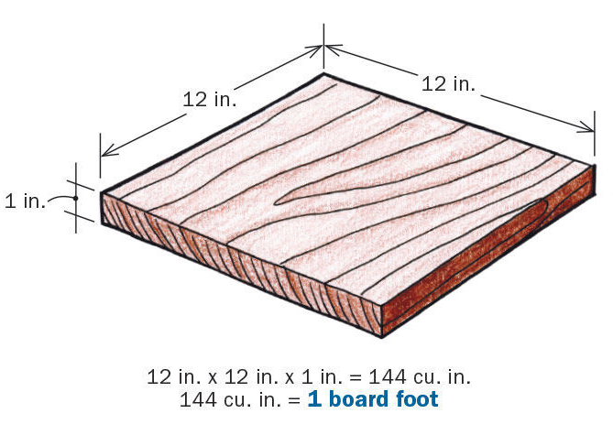
Board Foot
Hardwoods (oak, poplar, walnut) are rarely sold in standard dimensions the way softwoods are. Instead, suppliers generally sell hardwoods in a unit of volume known as the board foot. One board foot is equal to 144 cubic inches of wood.

Slide 5
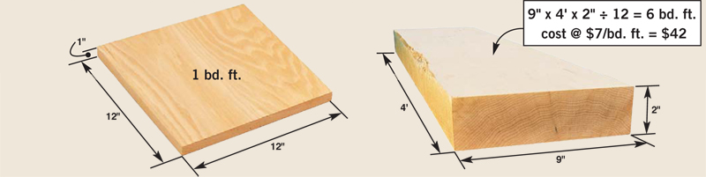
Board Foot is the VOLUME of a board

