Slide 1

Imagine…
if we could activate the entrepreneurial mindset of an entire generation.

Slide 2

Why Entrepreneurship?

Slide 3
A Global Call to Action
We must equip youth to participate in the innovation economy, whether as entrepreneurs or as entrepreneurial employees.
34.3%
1
3
600M
20%
25%
IN
1 in 3 U.S. employers seeks entrepreneurial experience in its hires.
By the year 2030, there will be at least 600 million more young people looking for work than projected jobs globally.
New businesses account for nearly all net new job creation and almost 20% of gross job creation in the United States.
Entrepreneurs age 20‒34 have been on the decline in the United States, down from 34.3% of all new entrepreneurs in the 1997 Kauffman Index to 25% in the 2016 index.
Source: Millennial Branding; 2012 Gallup Student Poll
Source: International Organizations; The World Bank
Notes:
TP: NFTE has identified macro trends indicating that entrepreneurial skills are vital, both to a young person’s individual success and to overall economic vitality.
[Feel free to hone in on the stats that are most important to your audience, e.g., 1 in 3 employers for schools, 34.3% for foundations.]

Slide 4
NFTE Chicago Mission
NFTE Chicago Metro is invested in cultivating an entrepreneurial ecosystem for under-served youth. Our network of teachers, students, community organizations, business professionals, and local entrepreneurs work together to foster real-world opportunities for our youth to apply their entrepreneurial skills and reach their future goals. NFTE Chicago Metro envisions that this generation of youth will be active contributors in shaping Chicago's economic futures.

Slide 5
NFTE Impact
NFTE students apply the entrepreneurial mindset—succeeding in the workplace, starting businesses, and furthering their education.
86%
80%
1
4
50%+
IN
of NFTE alumni are either employed or furthering their education.
of NFTE alumni are in college or have graduated college.
NFTE alumni have started at least one business.
NFTE alumni earn 50% more than their peers.
Notes:
[For your reference, here are some comparison national statistics.]
In the United States population:
• Only 15% of low-income high-school students complete a career-ready curriculum. (2016 The Education Trust)
• 54.8% of 16-to-24-year-olds are employed (US Dept of Labor, July 2017, https://www.bls.gov/news.release/youth.nr0.htm)
• 69.7% of recent high-school graduates (age 16-to-24) are enrolled in college. (US Dept of Labor, October 2016, https://www.bls.gov/news.release/hsgec.nr0.htm)
• Only 2% of youth aged 16–24 were self-employed in 2015. (2016 U.S. Bureau of Labor Statistics)

Slide 6








Our Focus: Activating the Entrepreneurial Mindset
NFTE empowers youth to approach the world with an innovator’s eye and a founder’s grit, not only during the NFTE course but for the rest of their lives. We define the entrepreneurial mindset as eight key pillars proven to drive success.
Initiative
& Self-Reliance
Flexibility
& Adaptability
Communication
& Collaboration
Creativity
& Innovation
The power to take ownership without input or guidance and to work through obstacles independently.
The ability and willingness to change actions and plans to over-come present and future challenges.
The ability to clearly express ideas to an intended audience, including persuading others to work towards a common goal.
The ability to think of ideas and create solutions to problems without clearly defined structures.
Future
Orientation
Critical Thinking
& Problem Solving
Opportunity
Recognition
Comfort
with Risk
An optimistic disposition with a focus on obtaining the skills and knowledge required to transition into a career.
The process of applying higher-level, process-oriented thinking skills, and of transitioning that reasoning to decision making.
The practice of seeing and experiencing problems as opportunities to create solutions.
The capacity to move forward with a decision despite inevitable uncertainty and challenges.
Notes:
TP:
NFTE’s head of Research and Evaluation likes to say that since NFTE’s founding, we’ve been doing something very unique, but we didn’t really talk about it in the right way until recently.
NFTE’s impact is helping young people to develop the entrepreneurial mindset, a set of noncognitive skills that have been shown to support short- and long-term academic and career success.
The entrepreneurial mindset provides the foundation for young people to succeed in a variety of ways, as you saw in NFTE’s impact data a few slides earlier (success in school, in employment, in starting businesses).

Slide 7


NFTE Entrepreneurship Pathway
In an innovation economy, there are no traditional paths to success. NFTE’s Pathway begins with igniting the imagination and takes students through the journey of activating their entrepreneurial mindset and creating their own businesses.
Awareness Programs
Exposure Programs
Expertise Programs
Application Programs
World Series of Innovation
Exploring Careers: Introduction to Entrepreneurship and the Working World
Entrepreneurship 1: Business Ideation and Crafting the Pitch
Entrepreneurship 2: Business Model Validation and Product Development
A global, online experience where students create business solutions aligned with the UN Sustainable Development Goals
An award-winning course, focused on activating the entrepreneurial mindset as well as creating and pitching an original business plan
An advanced course that deepens the entrepreneurial mindset and centers
on business model validation, product development, and marketing
A course where students discover their interests and begin to develop an entrepreneurial mindset
MODULAR
IN SCHOOL
IN SCHOOL
IN SCHOOL
CERTIFICATION
Venture
Startup Tech: Introduction to Entrepreneurship and App Development
BizCamp: Business Ideation and Crafting the Pitch
Startup Summer: Business Model Validation and Product Development
A digital experience introducing students to entrepreneurship through the process of building a virtual food truck business
Entrepreneurship 1, delivered as a multi-week learning experience
A blended tech-entrepreneurship course where students create an app and corresponding business plan
Entrepreneurship 2, delivered as a 16-week learning experience
MODULAR
IN SCHOOL
OUT OF SCHOOL
OUT OF SCHOOL
Students who complete Entrepreneurship 1 and 2 are prepared to take the Certiport Entrepreneurship and Small Business exam for certification. The NFTE curriculum is Certiport-recommended.
Notes:
TP:
NFTE’s Pathway is a portfolio of programs designed to activate and develop the entrepreneurial mindset in young people, with increasing depth as we move from Awareness programs into Exposure, Expertise, and Application programs.
NFTE allows schools to select whatever programs best align with schedules and priorities.
Should a district or school also want the option of certification, Entrepreneurship 1 and Entrepreneurship 2 offer this option, preparing students to take the Certiport Entrepreneurship and Small Business exam. The American Council on Education (ACE) has approved the exam for three introductory level college credits. Students who pass are eligible to receive those credits from 1,800 ACE member colleges.

Slide 8
NFTE Entrepreneurship Pathway: Exposure Programs
Exposure programs begin to activate the entrepreneurial mindset in students and teach key entrepreneurship concepts.
Level
Duration
Student
Competition
Final Project
Student
Assessment
Teacher
Resources
Volunteer
Integration
NFTE Exploring Careers: Introduction to Entrepreneurship and the Working World
Grades
7–10
Full year or
one semester
Startup Showcase with prizes for top teams
Business concept and marketing materials, created in teams
Content and Entrepreneurial Mindset evaluated through formative assessments, Showcase presentation, and classroom rubrics
Full benefits of Entrepreneurial Teacher Corps
Expo judging
NFTE Startup Tech: Introduction to Entrepreneurship and App Development
Grades
5–12
Full year
Startup Showcase with prizes for top teams
Business concept, functional app, and marketing materials, created in teams
Content and Entrepreneurial Mindset evaluated through formative assessments, Showcase presentation, and classroom rubrics
Full benefits of Entrepreneurial Teacher Corps
Expo judging

Slide 9
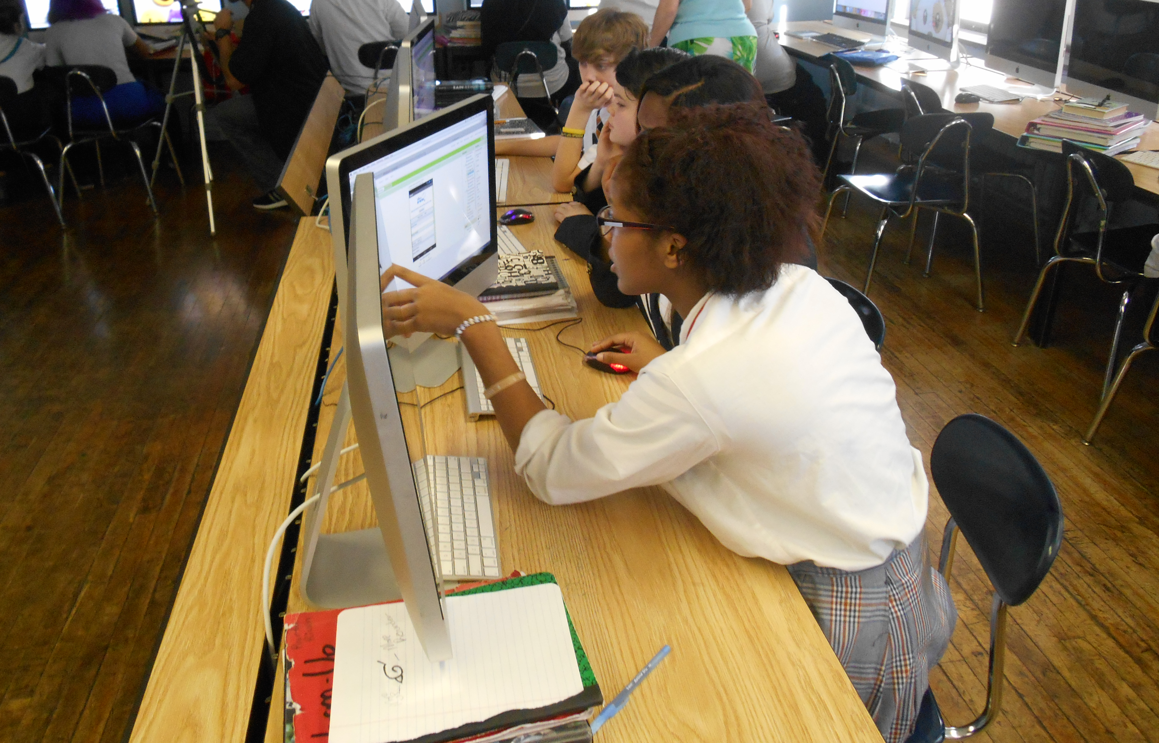
NFTE Startup Tech: Program Content
7 units of learning ask students to identify ways to improve their world and to build marketable digital solutions.
Introduction to Startup Tech: Students will be introduced to the entrepreneurial mindset and skills that can help them achieve success in both tech entrepreneurship and in life.
Introduction to MIT App Inventor: Students will explore MIT App Inventor, a drag-and-drop mobile app creation tool that they will use to create a functional mobile app.
Technology and Entrepreneurship in Healthcare: Students will research the Healthcare sector and build a healthcare app that shows patients a map of doctors in their area.
Technology and Entrepreneurship in Business and Finance: Students will research the Business and Finance sector and build a business app that enables small business owners to send group texts to their employees.
Technology and Entrepreneurship in Environmental Science and Conservation: Students will research the Environmental Science and Conservation sector and build an environmental app that allows businesses to showcase sustainable products.
Advanced MIT App Inventor: Students will work in teams to complete advanced MIT App Inventor tutorials that will allow them to create more innovative features in their final project apps.
Preparing for the Startup Showcase: Students will work in teams to create their own original app idea as a final project. To complete the project and participate in the Startup Showcase, students conduct market research, determine a sustainable business model, design persuasive marketing materials, create wireframes of their app, translate their wireframes into functional mobile apps using MIT App Inventor, and ultimately present their work to a panel of judges.

Slide 10
NFTE Entrepreneurship Pathway: Expertise Programs
Expertise programs deepen students’ entrepreneurial mindset and startup skills.
Level
Duration
Student
Competition
Final Project
Student Assessment
Teacher
Resources
Volunteer
Integration
NFTE Entrepreneurship 1: Business Ideation and Crafting the Pitch
Grades
7–12
Full year
Youth Entrepreneurship Challenge, with business plan competitions starting locally and progressing to regional and national finals
Individually or with a partner, original business plan
Certiport Entrepreneurship
and Small Business exam
Additional Assessment: Content and Entrepreneurial Mindset evaluated through formative assessments, business pitch presentation, and classroom rubrics
Full benefits of Entrepreneurial Teacher Corps
Coaching, competition judging, guest speaking, field trip hosting
CERTIFICATION
NFTE BizCamp: Business Ideation and Crafting the Pitch
Grades 7–12
Multi-week: 80 hours of instruction
Top teams compete to participate in National Youth Entrepreneurship Challenge
Individually or with a partner, original business plan
Content and Entrepreneurial Mindset evaluated through formative assessments, business plan, pitch deck, and presentation
This program is taught by senior educators from NFTE's Entrepreneurial Teacher Corps.
Advising, competition judging, field trip hosting

Slide 11
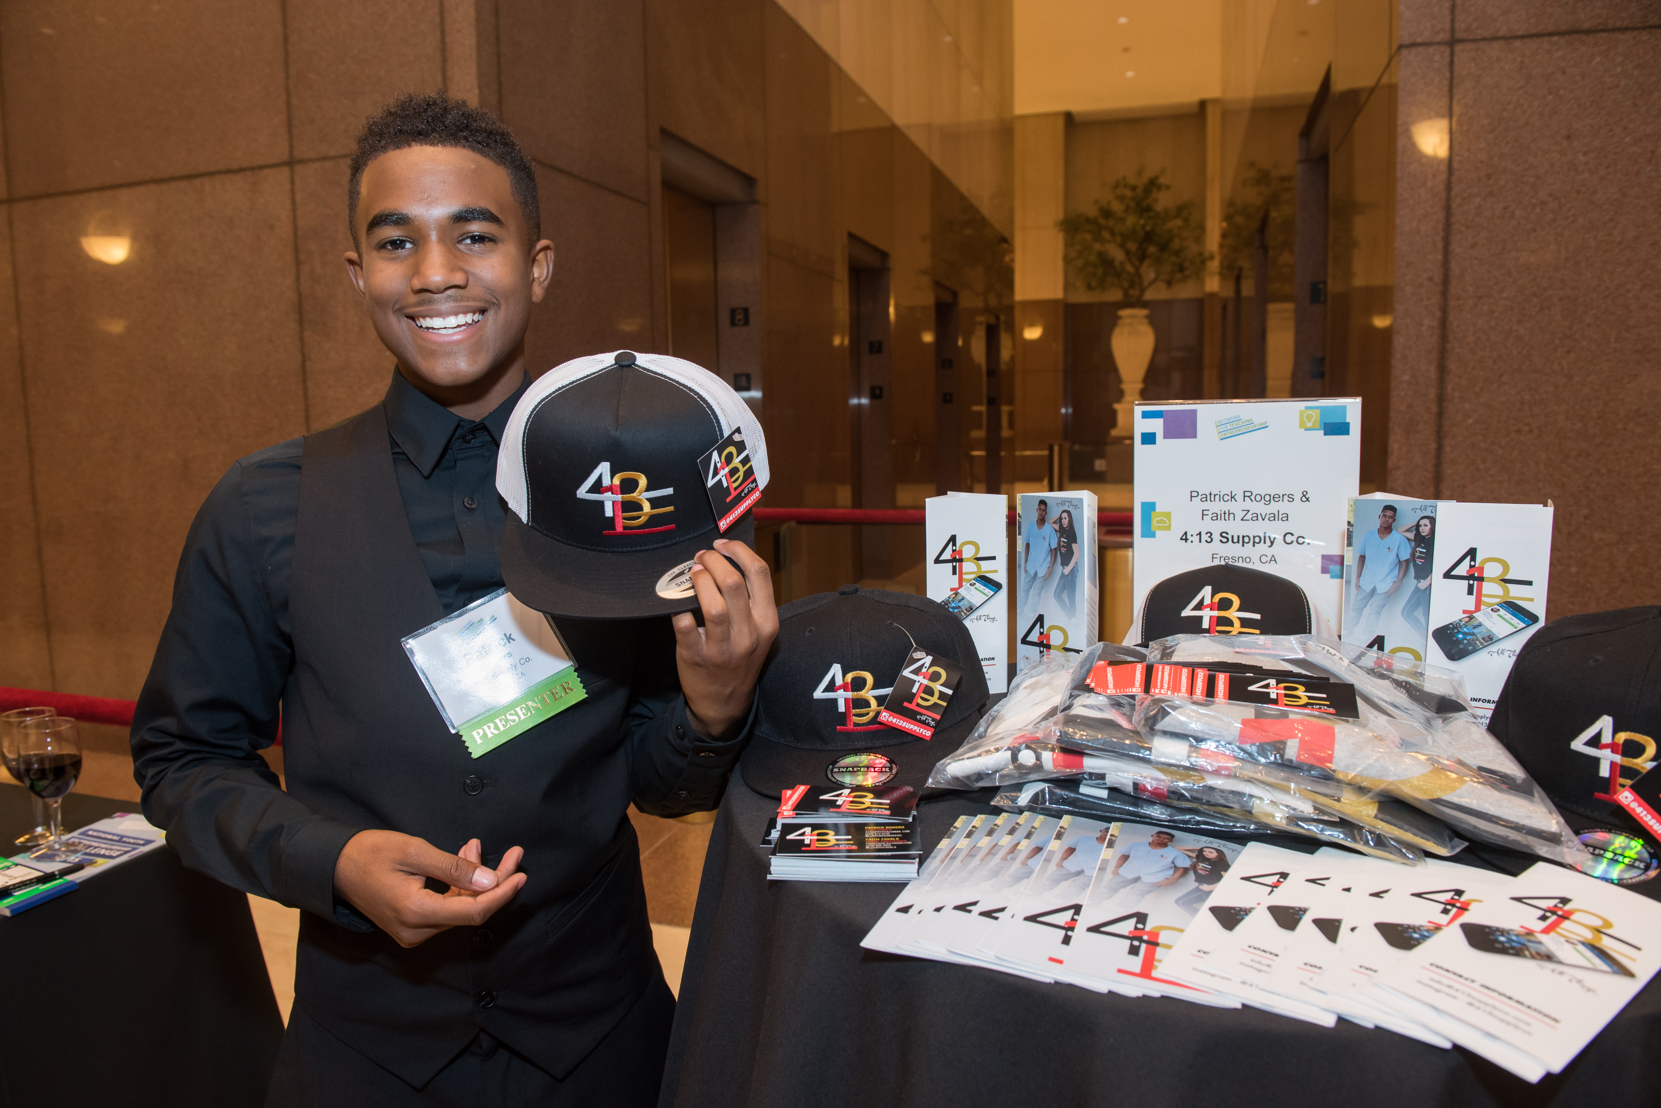
NFTE Entrepreneurship 1 / NFTE BizCamp: Program Content
8 units of learning teach the entrepreneurial mindset alongside traditional startup skills.
Developing an Entrepreneurial Mindset: Students learn the value of entrepreneurship to the economy, characteristics of successful entrepreneurs, how to be entrepreneurial within established organizations, and how entrepreneurship can help address social challenges.
Opportunity Recognition and Market Analysis: Students learn the distinction between a business idea and a business opportunity, and how to evaluate opportunities using market research and data analysis.
Competitive Analysis: Students explore the concepts of supply and demand and direct and indirect competition, and they learn how to develop competitive pricing and a competitive advantage.
Delivering Value to Customers: Students identify a target market, develop an understanding of their customer needs, and learn how to deliver and communicate value to customers.
Business Model: Students learn about channels of distribution, intellectual and human resources, business operations, and various business legal structures.
Financial and Expense Management: Students develop models related to the cost of doing business, expense management, revenue streams, and sales projections, as they explore business financing options and how to use financial analysis.
Operating the Business: Students examine best practices for managing the business, record-keeping, and accounting, while learning about how government regulations and taxes influence business.
Growing the Business: Students examine various strategies
for planning for business growth and expanding operations,
including recruiting and training staff as well as franchising and licensing options.

Slide 12
NFTE Entrepreneurship Pathway: Application Programs
Application programs are advanced learning experiences helping students to refine their business models and make their businesses operational.
Level
Duration
Student
Competition
Final Project
Student Assessment
Teacher
Resources
Volunteer
Integration
NFTE Entrepreneurship 2: Business Model Validation and Product Development
Grades
7–12
Full year
Investment Pitch competition, starting locally and progressing to regional and
national finals
An investment pitch deck and a minimum viable product
Certiport Entrepreneurship and Small Business exam
Additional Assessment: Content and Entrepreneurial Mindset evaluated through formative assessments, business plan, pitch deck, and presentation
Full benefits of Entrepreneurial Teacher Corps
Advising, competition judging
CERTIFICATION
NFTE Startup Summer: Business Model Validation and Product Development
Grades 11 and above
16 weeks
Investment pitch competition in the fall
An investment pitch deck, including a detailed financial plan
Content and Entrepreneurial Mindset evaluated through formative assessments, business plan, pitch deck, and presentation
This program is taught by senior educators from NFTE's Entrepreneurial Teacher Corps.
Advising, competition judging, field trip hosting

Slide 13

NFTE Entrepreneurship 2 / NFTE Startup Summer: Program Content
7 units of learning guide students in deepening their entrepreneurial mindset and building their businesses.
Growing Your Entrepreneurial Mindset—Leadership and Teamwork: Students participate in a series of challenges that require them to work as a team to solve complex problems. Students reflect on the entrepreneurial skills they used and their opportunities for growth.
Achieving Product-Market Fit: Students work collaboratively to develop a minimum viable product, conducting A/B testing with potential customers to validate product-market fit. Students also work on product development and positioning.
Designing a Business Model: Students research distribution channels, internal resources, and external partnerships that could benefit their business. Students also consider how to structure their business in order to optimize performance of key activities.
Utilizing Digital Marketing and Sales: While learning about selling strategies, students develop a website and social media campaign to market their business.
Planning for Business Operations: Students learn about human capital, intellectual property, basic recordkeeping, and basic accounting. Students consider the importance of ethics and how they can create socially responsible, sustainable businesses.
Financing a Startup: Students develop financial ratios and a projected income statement for their business. Students explore bootstrapping, crowdsourcing, using loans to finance new businesses, and credit scores.
Managing a Small Business: Students learn about human resources, government regulations, and taxes relevant to their business, in preparation for the Certiport Entrepreneurship and Small Business exam.

Slide 14
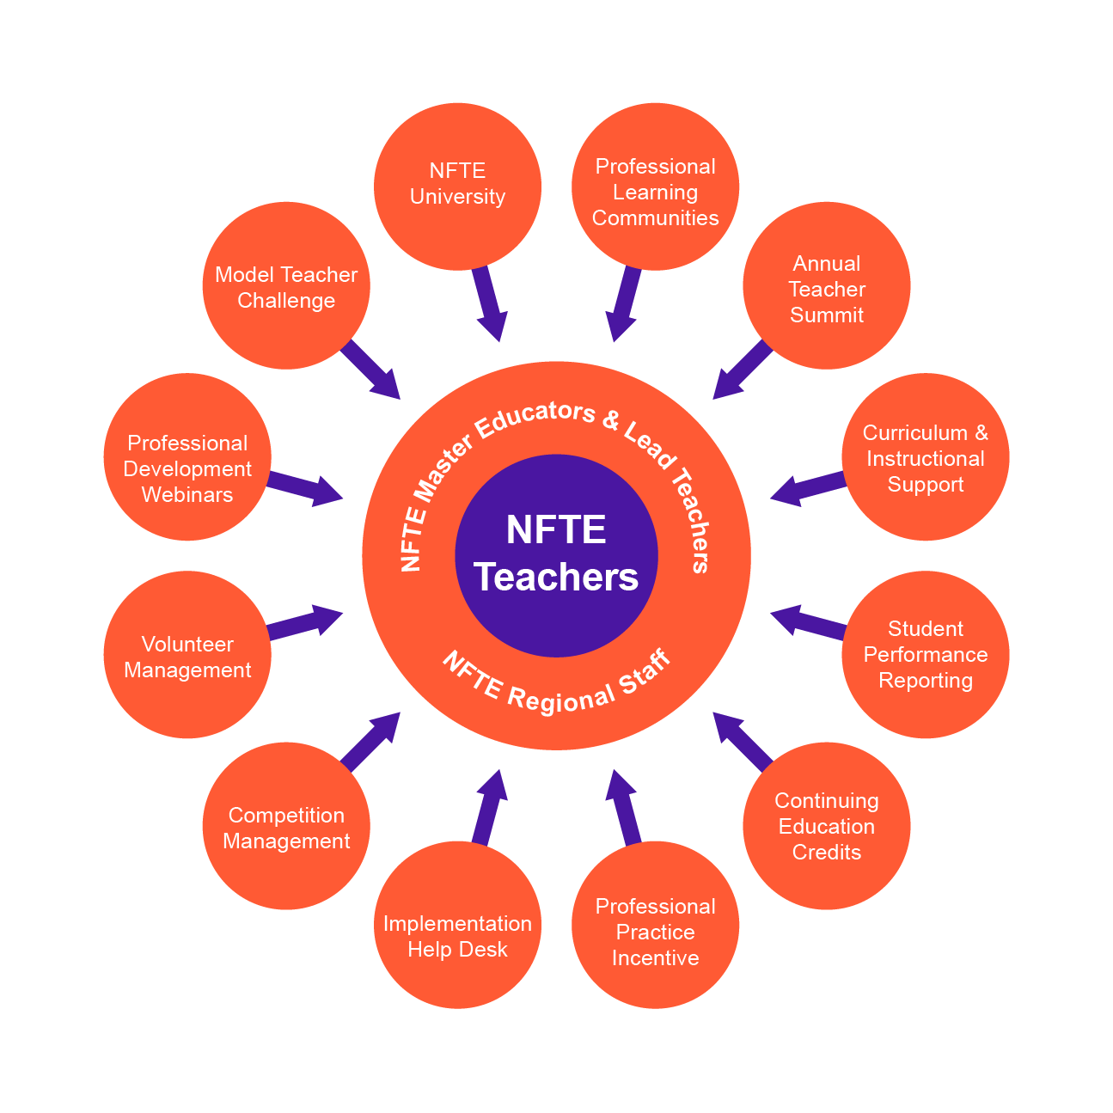
The Entrepreneurial Teacher Corps
Activating the entrepreneurial mindset of an entire generation begins with the Teacher Corps. Educators join a robust community of support, complete with professional development resources, NFTE curriculum, student performance reporting, and opportunities to learn from one another as well as from NFTE staff.
Notes:
TP:
Activating the entrepreneurial mindset in young people begins with teachers who model the mindset to students in inspiring ways. This requires a new model of NFTE teacher support.
Research indicates that teachers learn best from other teachers. Our new Entrepreneurial Teacher Corps takes this to heart, with the most successful seasoned NFTE educators acting as Master Educators and Lead Teachers to support all NFTE teachers.
Our new model focuses heavily on instructional practices that drive student success (in addition to content-focused training)

Slide 15

“NFTE U” Teacher Training
Educators learn how to:
Deliver project-based learning and the NFTE curriculum
Teach cognitive and non-cognitive skills, with a strong focus on practices that help teachers to activate the entrepreneurial mindset in students
Educators receive:
NFTE Certified Entrepreneurship Teacher (CET) designation, following successful completion of the training
Membership in the NFTE Entrepreneurial Teacher Corps

Slide 16
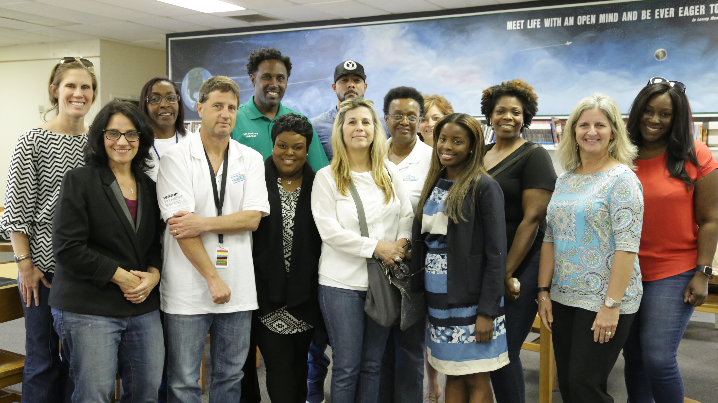
Ongoing Professional Development
Professional Learning Communities
Run by NFTE Lead Teachers and Master Educators
Practice-focused with all NFTE teachers partner to codify and grow best practices
Professional Development Webinars
Monthly webinars and an online video library
Content-focused training on teaching key entrepreneurship topics, including the entrepreneurial mindset

Slide 17












Enrichment/Support: Volunteerism and Workforce Connection

Slide 18
Real World Application: Landmark Agreement With CIBC Bank
“CIBC is proud to support these young entrepreneurs as they not only pursue their dreams of starting a business, but also create growth and opportunities in their neighborhoods,” said Larry D. Richman, President and Chief Executive Officer of CIBC. “CIBC has a mission to create stronger, more stable neighborhoods. We believe strongly that foster business growth in our communities is critical to achieving this goal.”
Innovative collaboration with CIBC Bank to provide micro-financing to NFTE youth seeking to launch businesses in their communities
Every NFTE Chicago Student who completes a business plan qualifies to apply and go before CIBC board comprised of banking officials
CIBC will also supply additional financial literacy training for students to maintain funding agreement

Slide 19
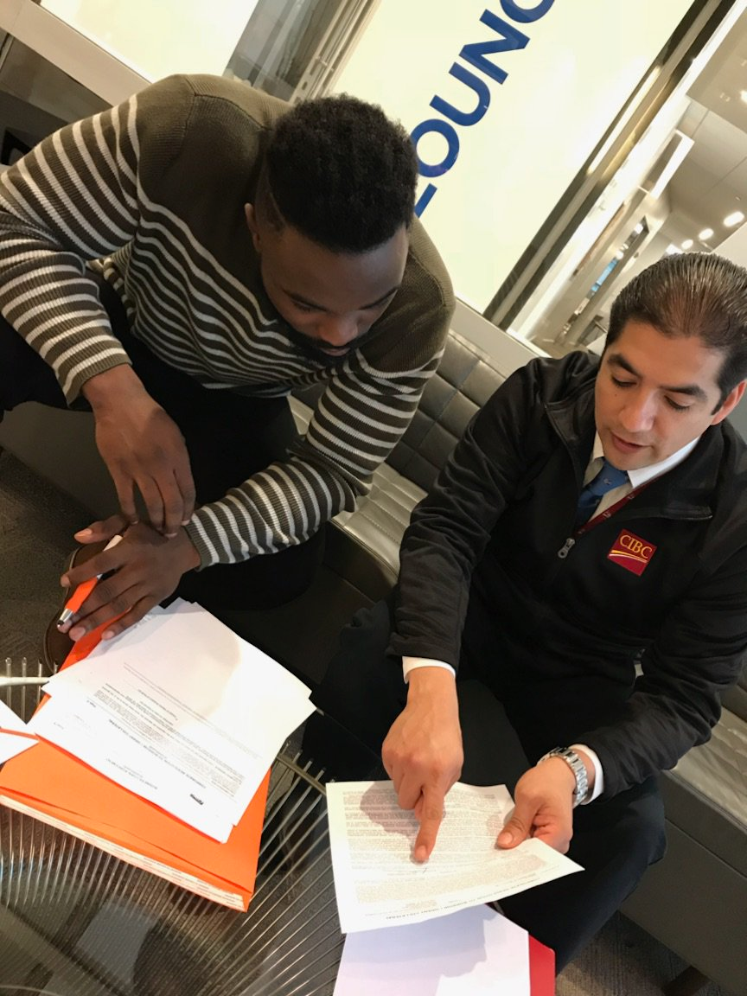
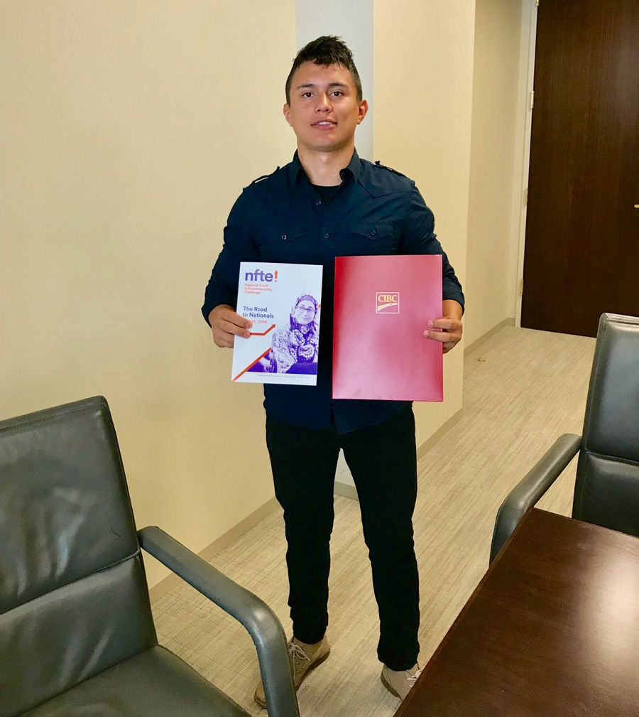
T&J Soccer Sign the First NFTE/CIBC Entrepreneur Loan

Slide 20

NFTE Chicago
Advancing Entrepreneurship
& Transforming Communities

