Slide 1
HOW TO BEND CONDUIT

Slide 2
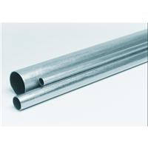
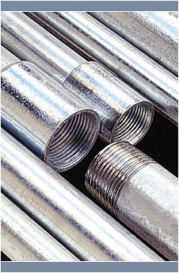
Emt and Rigid Metal Conduit
Electrical Metallic Tubing
Rigid Metal Conduit
thin-wall conduit
Definition
Electric conduit with a wall thickness that will not support threads. Sections are joined by couplings held in place by setscrews.
rigid metal conduit
Definition
Electrical conduit with wall thickness that is supported and joined by threaded couplings.

Slide 3
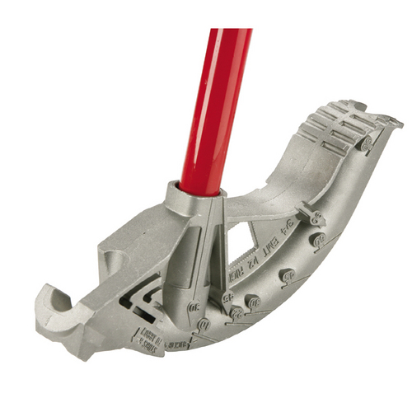
The Bender
Notes:
To aid bending when performing a ground or air bend, the benders are marked with different alignment symbols to help the operator create the bends necessary to accomplish any project. The symbols found on the benders are the arrow, the teardrop, the star point and angle markings. These markings are found on various sides of the bender head.

Slide 4
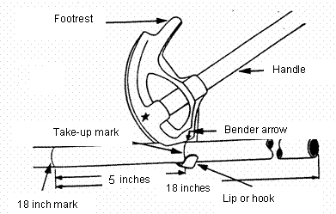
Parts of the Conduit Bender

Slide 5
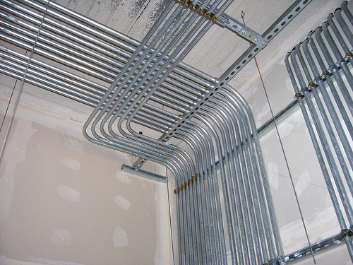
Purpose of a 90 Degree Bend
To turn up/down or left/right from a straight path.

Slide 6
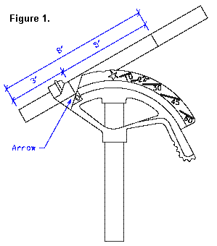
90 Degree Bend
Conduit Size Deduct
Place a mark on the conduit at the desired distance from the end of the conduit, minus the deduction for the bender.
½ in = 5 in deduct
¾ in = 6 in deduct
1 in = 8 in deduct
Notes:
Conduit deduct is the same measurement for Emt and Ridged pipe. Even thought Ridged and Emt pipe will have its own type of bender.

Slide 7
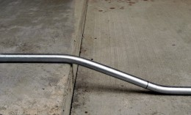
Purpose of a offset bend
Offset bends are used to move a run of conduit from one plane to another. An offset is normally used to bend the conduit around an obstruction, or to relocate the conduit close to a structural member to make it easier to fasten the conduit.

Slide 8
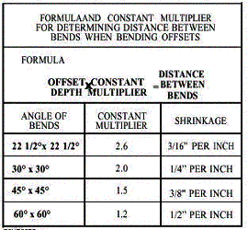
Offset Bend
Multipliers
10 in object for 30 degree bends
(10*2= 20 in space between marks)

Slide 9
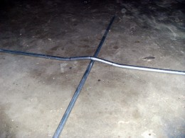
Purpose of a Three-Bend Saddle
Three bend saddles are often used to cross or saddle a small obstruction that would prevent the electrician from installing conduit in a straight line.

Slide 10
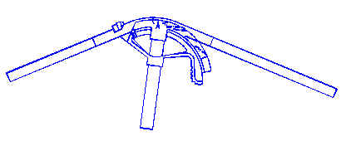
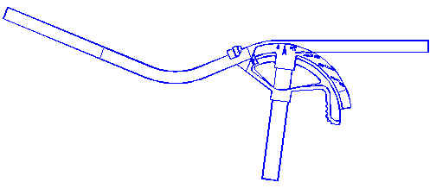
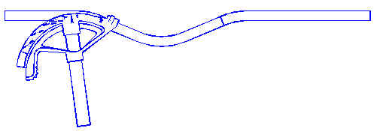
Three-Bend Saddle
Steps
Measure the length of obstruction; mark center point
Multiply the height of the obstruction by 2.5; mark distance on each side of the center mark
Bend center mark to 45 degrees on center mark of bender
Bend second mark to 22-1/2 angle at arrow
Bend the third mark to 22-1/2 and at arrow

Slide 11
HOW OFTEN A BEND IS USED

