Slide 1
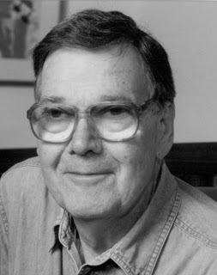
The Original Career Counselor
Dr. John Holland (1919‐ 2008) developed a theory that people’s interests, values, and strengths can be arranged into six basic categories (personality traits).
Notes:
Way before there was a Ms. Dewey or Mrs. Uremovic their was the Original Career Counselor-John Holland, a prominent career choice theorist. Theory and research document the fact that individuals are likely to perform better and achieve satisfaction in work when they perform job duties that allow them to engage in activities in which they have interest and skill.

Slide 2
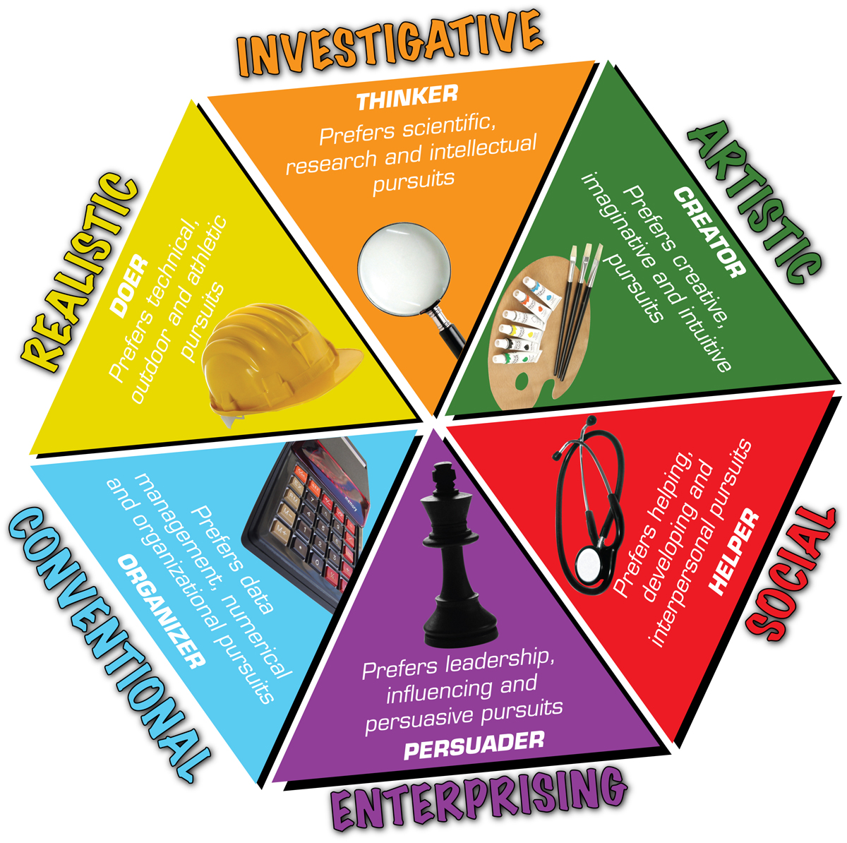
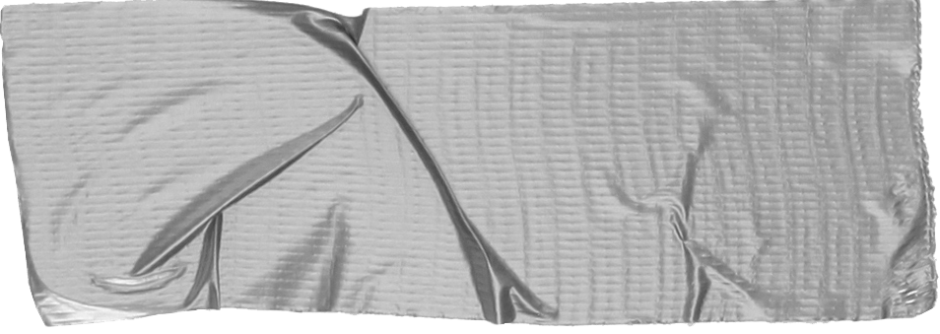
Each of us has a leaning towards one trait, with two supporting traits.
Your combination of these three core areas is your Holland Code.
Knowing your Holland Code can help you find a career aligns with your interests, values, and skills.
Tip
Don’t wait till the end of the presentation to give the bottom line.
Reveal your product or idea (in this case a translation app) up front.
Notes:
Many of you took the career interest profiler and were given your three highest interest areas. The combo of those give you your Holland Code-next slide is an example
You want to choose an occupation that fits your unique qualities -- your abilities, talents, needs, values, and interests -- and the life-style you want to live.
Knowing your "unique qualities" is not easy. Learning about yourself is a challenge for everyone. But, the clearer picture you have, the more likely you are to choose a satisfying career.

Slide 3
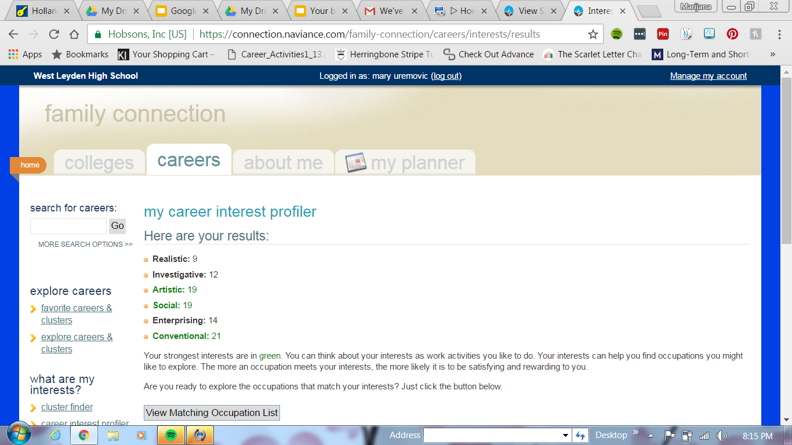
Notes:
An example of the career interest profiler on Naviance

Slide 4
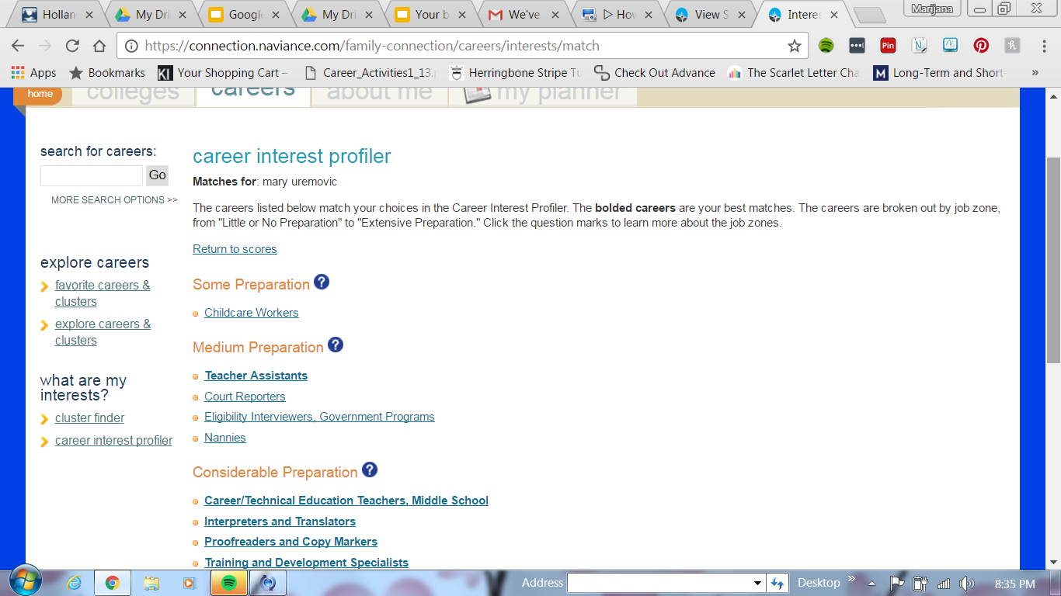
Notes:
Careers that match my choices in the Career Interest Profiler

Slide 5
Prefer practical, hands‐on tasks & assignments
Motivated by an ability to achieve results
Like building, repairing, problem‐solving • May prefer working outside conventional workspaces
Tip
Tell the audience about the problem through a story, ideally a person.
Notes:
Likes to work with animals, tools, or machines; generally avoids social activities like teaching, healing, and informing others;
Has good skills in working with tools, mechanical or electrical drawings, machines, or plants and animals;
Values practical things you can see, touch, and use like plants and animals, tools, equipment, or machines; and
Sees self as practical, mechanical, and realistic.
Firefighter

Slide 6
• Get their energy from helping people
• Enjoy informing, training, empowering others
Tip
If one example isn’t sufficient to help people understand the breadth of your idea, pick a couple of examples.
Story for illustration purposes only
Notes:
Likes to do things to help people -- like, teaching, nursing, or giving first aid, providing information; generally avoids using machines, tools, or animals to achieve a goal;
Is good at teaching, counseling, nursing, or giving information;
Values helping people and solving social problems; and
Sees self as helpful, friendly, and trustworthy.
Customer Service

Slide 7
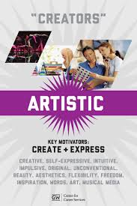
Like being creative
Motivated by self‐ expression,creativity, and imagination
Prefer unstructured work environments
Tip
Tell the audience about the problem through a story, ideally a person.
Notes:
Likes to do creative activities like art, drama, crafts, dance, music, or creative writing; generally avoids highly ordered or repetitive activities;
Has good artistic abilities -- in creative writing, drama, crafts, music, or art;
Values the creative arts -- like drama, music, art, or the works of creative writers; and
Sees self as expressive, original, and independent.
Fashion Designer

Slide 8
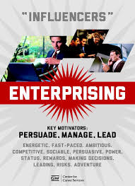
• Are drawn toward projects and positions which allow them to influence change
• Like to steer the direction of outcomes through assertive, energetic communication
Tip
If one example isn’t sufficient to help people understand the breadth of your idea, pick a couple of examples.
Notes:
Likes to lead and persuade people, and to sell things and ideas; generally avoids activities that require careful observation and scientific, analytical thinking;
Is good at leading people and selling things or ideas;
Values success in politics, leadership, or business; and
Sees self as energetic, ambitious, and sociable.
Real Estate

Slide 9
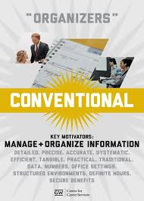
Solve problems by applying rules, laws, and formulas.
Are typically well ‐ organized, with attention to detail
Take an analytical approach to life
Tip
Tell the audience about the problem through a story, ideally a person.
Notes:
Likes to work with numbers, records, or machines in a set, orderly way; generally avoids ambiguous, unstructured activities
Is good at working with written records and numbers in a systematic, orderly way;
Values success in business; and
Sees self as orderly, and good at following a set plan.
Bank Teller

Slide 10
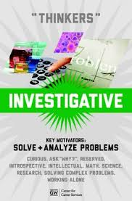
Driven by curiosity
Like trouble‐shooting and exploring things
Drawn towards abstract problems
Enjoy intellectual challenges
Take a scientific approach to life
Tip
If one example isn’t sufficient to help people understand the breadth of your idea, pick a couple of examples.
Notes:
Likes to work with animals, tools, or machines; generally avoids social activities like teaching, healing, and informing others;
Has good skills in working with tools, mechanical or electrical drawings, machines, or plants and animals;
Values practical things you can see, touch, and use like plants and animals, tools, equipment, or machines; and
Sees self as practical, mechanical, and realistic.
economist

Slide 11
Notes:
Activity-Guess the Holland Code

Slide 12
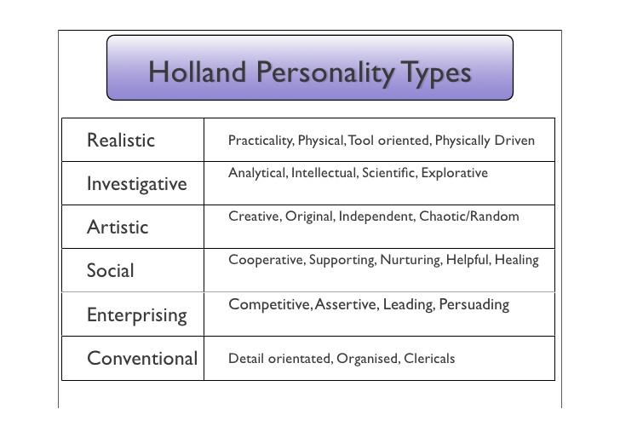

Slide 13
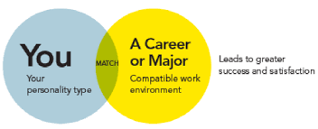
Notes:
What’s your Holland Code--Look up on Naviance

Slide 14
Let’s explore your own Holland Code and career paths that may be right for you!

Slide 15
What’s your Holland Code?
Log into Naviance, go the Careers tab and click on Career Interest Profiler.
Add your code to the worksheet.

Slide 16
View your Matching Occupation list and pick two careers that interest you the most. Use these two careers, Naviance and the website My Next Move to complete your Career Choices worksheet.

